Slide 1
Optimizing Trading Strategies with Reinforcement Learning
Amulya Saxena
Travis Desell

Slide 2
Agenda – Stand up III
Update
Code Commits
Experiments

Slide 3
Update
Mid July – researched and documented next steps for fall semester
End Aug – Started studying and coding momentum-based strategies
Mid Sept – Experimenting with Moving averages and Relative strength index
Notes:
The only hold up is that, I need to see a lot of videos understanding the technical terms
- As each strategy is different and involves different components

Slide 4
Update
Implemented
UI Framework
Reinforce Algorithm
In Progress
Forecasting Model Integration
RL Agent (Experimenting with Different Algos)
UI – Giving errors with data integration
Notes:
Reinforce - directly optimizes the policy (i.e., the agent's behavior) by adjusting its parameters to maximize the expected reward
policy gradient method that learns directly from interactions with the environment
can suffer from high variance and slow convergence, it provides a strong starting point for understanding and implementing policy-based reinforcement learning
simplicity and flexibility

Slide 5
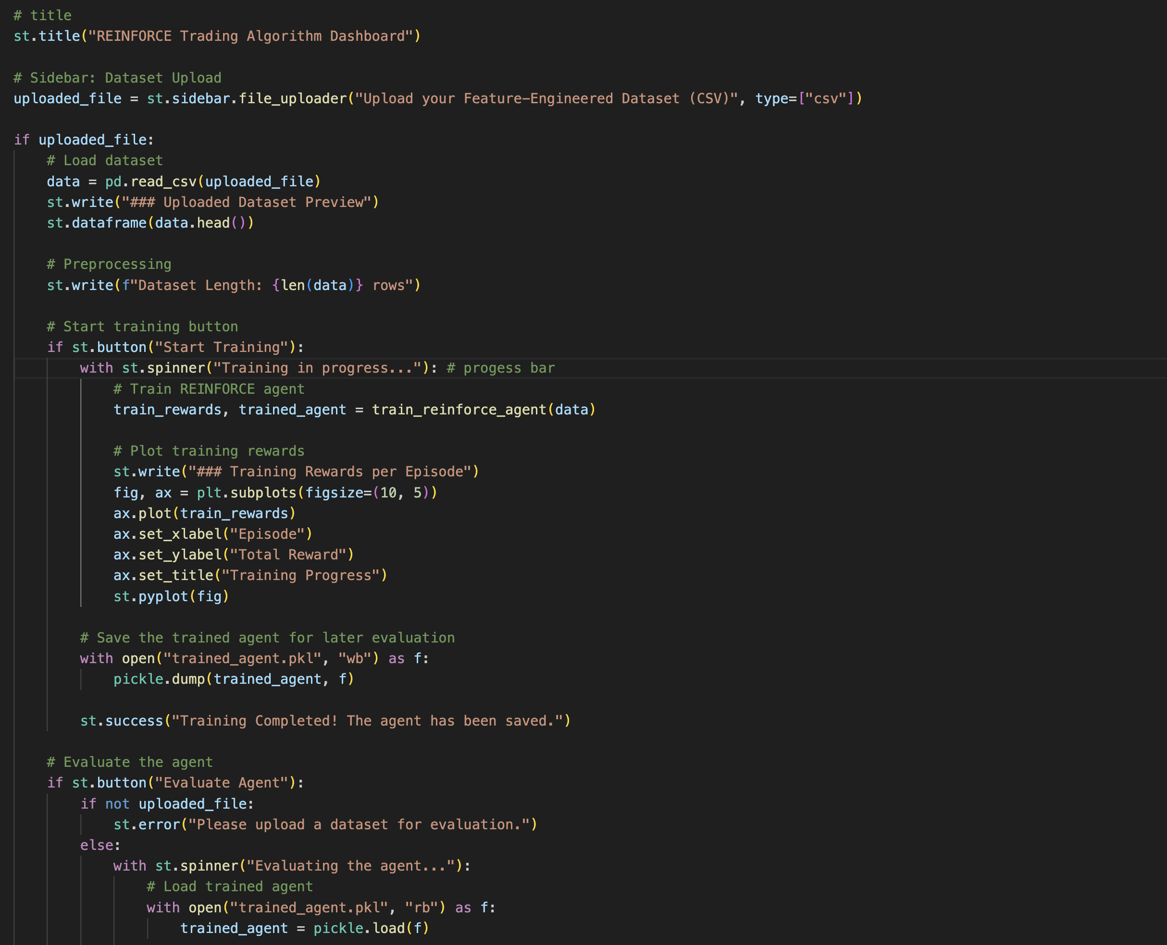
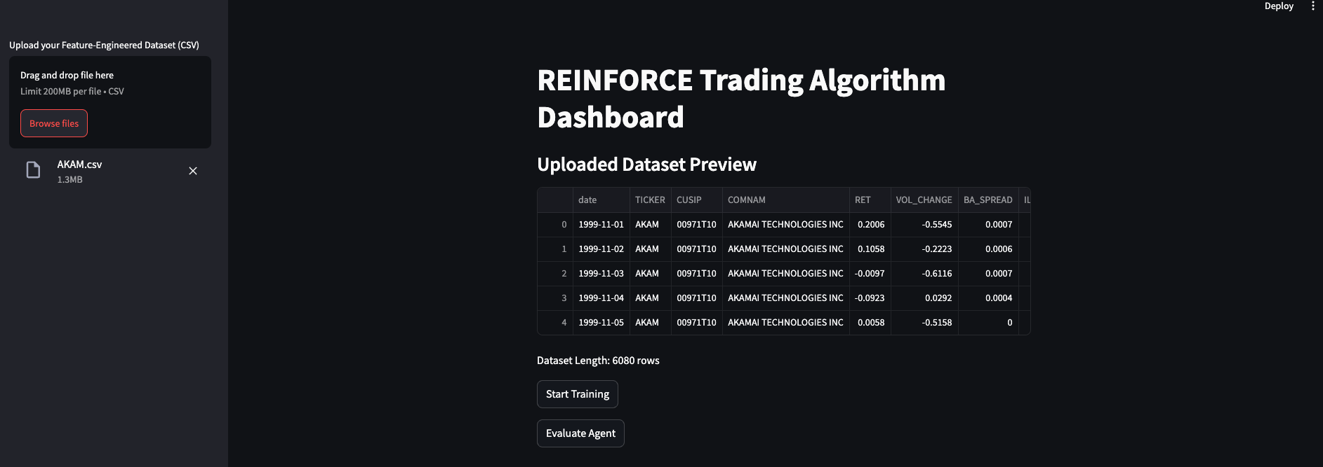

Slide 6
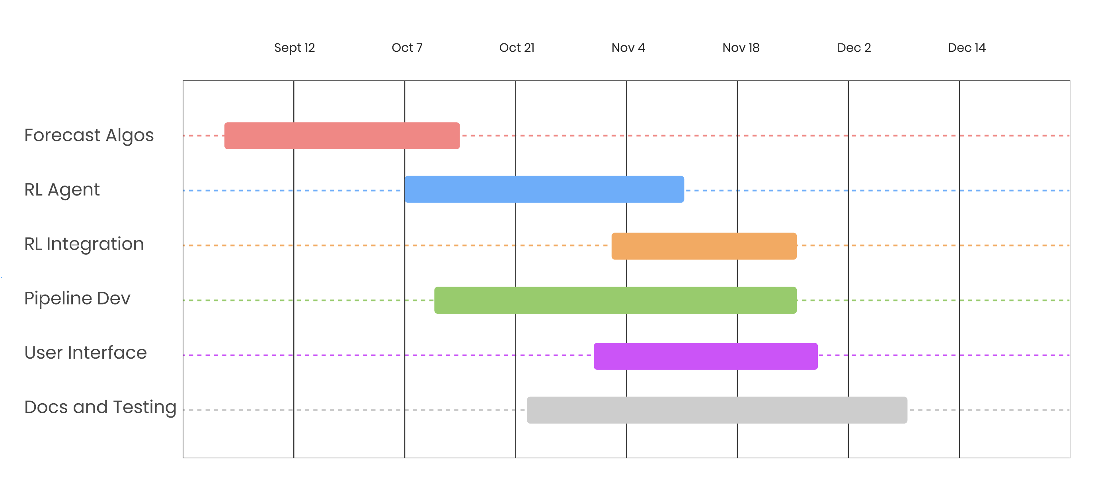
Gantt Chart

Slide 7
Update
Implemented
LSTM – Predicting Algorithm
Feature Importance and Selection
In Progress
VAR Model
TimeMixer Integration
RL Agent (Experimenting with Different Algos)
RL Environment

Slide 8
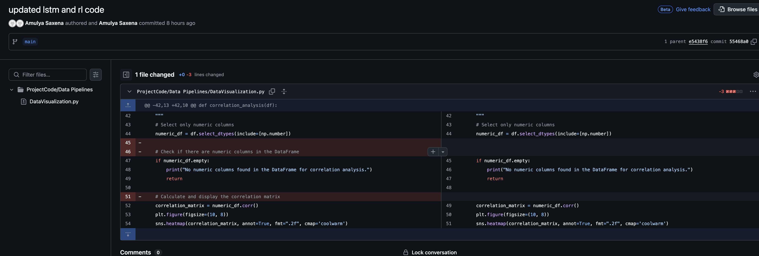

Slide 9
Experiments
Predicting Price and Returns using LSTM
1 Day
30 Days (Throwing error)
Notes:
Total Return shows how much profit the strategy made as a percentage of the initial capital.
Max Drawdown shows the worst-case scenario of how much the portfolio could have lost from its highest point.
Sharpe Ratio evaluates how much return you earned for the risk you took, with a higher ratio indicating a better risk-adjusted return.

